Slide 1
Segmentation tool for neighbourhoods

Slide 2

The problem
The aim of this project is to cluster similar neighbourhoods in the city of toronto together so that people can easily choose where to live based on their interests, lifestyle, and the data of each neighbourhood.
This tool can also be used by real estate agents to find the suitable location for the customer based on their interests and lifestyle.
This project clusters neighbourhoods according to the number venues, like: parks, museums, restaurants, and cafes, each one of them has.

Slide 3

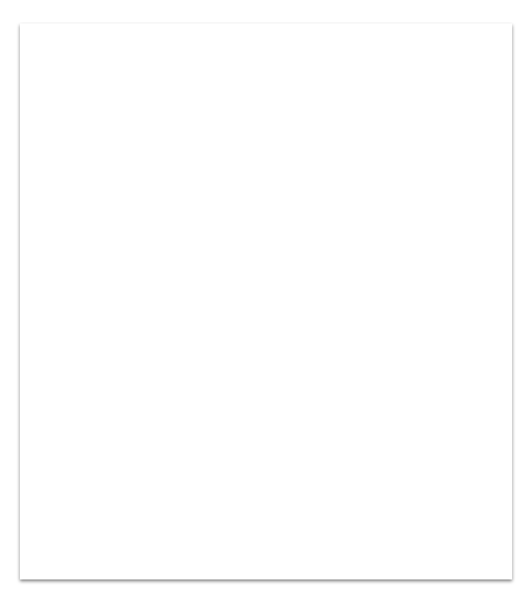
Data Used
Foursquare API:
Venues data
Wikipedia:
Neighbourhood names
Neighbourhood postal codes

Slide 4
AI used
The Kmeans algorithm was used to cluster neighbourhoods according to the number of venues they have.

Slide 5

Results:
The results of this project is a dataframe with all the neighbourhoods of Toronto, their coordinates, number of venues, most common venue type, borough, postal code, and a cluster label indicating the cluster they belong to.
The dataframe was used to draw a map with the neighbourhoods positioned on top of it and colour coded according to their cluster.

